Slide 1
Chapter 1 Questions

Slide 2
Question 1
Carbon is in Group 4A
Carbon can form up to four bonds
Carbon has 4 valence electrons
Carbon can form relatively strong carbon to carbon bonds

Slide 3
Question 2
Isotopes are atoms of the same element with a different mass, due to a different number of neutrons within the nucleus

Slide 4
Question 3
s orbital : spherical, can hold 2 electrons
p orbital: dumbbell shaped, can hold 6 electrons (2 in each orbital)
d orbital: double dumbbell, can hold 10 electrons (2 in each orbital)
f orbital: can hold 14 electrons (2 in each orbital)

Slide 5
Question 4
Orbitals are organized and grouped into shells

Slide 6
6s 6p 6d 6f
5s 5p 5d 5f
4s 4p 4d 4f
3s 3p 3d
2s 2p
1s

Slide 7
Question 5
The Aufbau principle is the build up principle, electrons are initially placed in the lowest orbitals in increasing order

Slide 8
Question 6
Electrons can have two orientations, but two electrons within the same orbital must have different spins.

Slide 9
Question 7
If two or more empty orbitals of equal energy are empty, electrons will occupy each one with parallel spins until each orbital has 1 electron

Slide 10
Question 8
Ground state electron configuration of Phosphorous
1s2 2s2 2p6 3s2 3p3

Slide 11
Question 9
In a covalent bond, electrons are shared between the two atoms
In an ionic bond, electrons are held closer to one atom than another (electrons are closer to the more electronegative atom)

Slide 12
Question 10
H H H H
·· ·· ·· ··
H : C : C : C : C : H
·· ·· ·· ··
H H H H

Slide 13
H H H H
H C C C C H
H H H H

Slide 14
Question 11
Sigma bonds are formed as single bonds
Pi bonds form the double and triple bonds

Slide 15
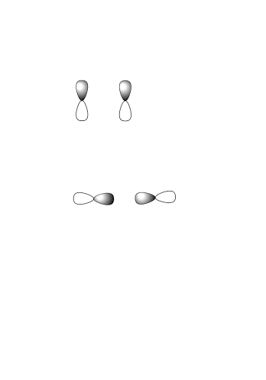
Question 12
Sigma bonds are formed by cylindrically symmetrical overlap

Slide 16
Question 13
Pi bonds are formed when a sideways overlap occurs

Slide 17
Question 14
Single bonds are the weakest
Triple bonds are the strongest
Single bonds are the longest
Triple bonds are the shortest

Slide 18
Question 15
You determine the hybridization of an atom by counting the number of atoms and lone pairs that are attached

Slide 19
Question 16
Hybridization | Bond Angle | Molecular Geometry
sp | 180° | Linear
sp2 | 120° | Planar
sp3 | 109.5° | Tetrahedral

Slide 20
Chapter 2 Questions

Slide 21
Question 1
Electronegativity is the ability of an atom to attract/ pull electrons towards itself

Slide 22
Question 2
Fluorine is the most electronegative element

Slide 23
Question 3

Slide 24
Question 4
Nonpolar covalent bonds:
  0 to 0.4
Polar covalent bonds:
  0.4 to 2
Ionic Bonds:
  Greater than 2

Slide 25
Question 5
A dipole moment is the net molecular polarity due to the difference in the summed charges

Slide 26
Question 6
Dipole moments are represented by an arrow with one line through the center
The line originates from the positively charged side, and goes towards the negatively charged side

Slide 27

Question 7
The formal charge of the atom is calculated as follows:
$\# free valence electrons −\# of bound electrons$

Slide 28
Question 8
A molecule that is in resonance is actually a hybrid of all of the resonance forms

Slide 29
Question 9
A. Electron flow is represented by curly arrows
B. The three atom unit must be present
C. Only electron placement has changed throughout the resonance forms, the arrangement of the atoms remains the same

Slide 30
Question 10
Bronsted Definitions:
  Acid: A substance that donates a proton
  Base: A substance that accepts a proton

Slide 31
Question 11
Organic Definition:
  Acid: Characterized by the presence of positively polarized hydrogen atoms (delta plus due to nearby E.N. elements)
  Base: Atoms with lone pairs (that can “grab” the positively polarized hydrogen)

Slide 32
Question 12
Lewis Definitions:
  Acid: Electron pair acceptors
  Base: Electron pair donors

Slide 33
Question 13
Strong acids produce weak conjugate bases
Weak acids produce strong conjugate bases

Slide 34
Question 14
Strong acids have:
  A large Ka
  A small pKa

Slide 35
Question 15
Weak acids have:
  A small Ka
  A large pKa

Slide 36
Question 16
The concentration of water at 25°C is 55.6 M

Slide 37
Question 17
An acid is strong when it can easily give off it’s proton

Slide 38
Question 18
A base is strong when it can “grab” a proton and hold on to it easily.

Slide 39
Question 19
Metal cations
Group 3A elements (BF3 and AlCl3)
Hydrogen-Halogen
Transition Metal Compounds

Slide 40
Question 20
Most oxygen and nitrogen containing compounds
Compounds that have lone pairs
Hydroxide ion
Iodine ion
Halides

Slide 41
Question 21
Amphoteric means that the molecule can act as either an acid or a base

Slide 42
Question 22
Dipole Dipole: Forces that occur between polar molecules due to electrostatic interactions (interactions between cations and anions)
Dispersion Forces: Forces between neighboring molecules due to the constantly changing positions of electrons
Hydrogen Bonds: The most important forces in biological molecules, attractive interactions between a hydrogen bonded to an electronegative atom and an unshared pare of electrons on another atom (Hydrogen bonding is FON)

Slide 43
Chapter 3 Questions

Slide 44
Question 1
CnH2n+2

Slide 45
Question 2
A saturated alkane has the total possible number of hydrogens attached to the carbons

Slide 46
Question 3
Methane | CH₄ | Heptane | C₇H₁₆
Ethane | C₂H₆ | Octane | C₈H₁₈
Propane | C₃H₈ | Nonane | C₉H₂₀
Butane | C₄H₁₀ | Decane | C₁₀H₂₂
Pentane | C₅H₁₂ | Undecane | C₁₁H₂₄
Hexane | C₆H₁₄ | Dodecane | C₁₂H₂₆

Slide 47
Question 4
A constitutional isomer is a structure that has the same molecular formula but different connectivity of the atoms

Slide 48
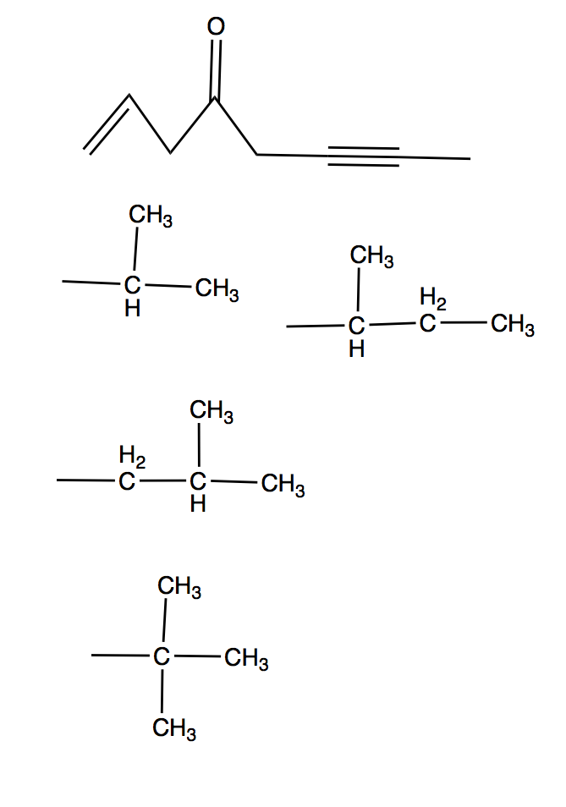
Question 5
Isopropyl
Isobutyl
Sec-butyl
Tert-butyl

Slide 49
Question 6
The degree of substitution of a carbon is determined by the number of carbons it is attached to
  Primary, Secondary, Tertiary and Quaternary

Slide 50
Question 7
    1. Find the parent/ longest chain; if two different parent chains have equal lengths, choose the backbone that gives rise to the most side chains.
    2. Start numbering from the side so that the substituents (side chains) have the lowest numbers possible
    3. When naming side groups, name them in alphabetical order

Slide 51
Question 8
As chain length increases, the boiling/ melting point increases
As the side chain length increases, the boiling/ melting point decreases

