Slide 1
Chapters 4-7 Test Review

Slide 2
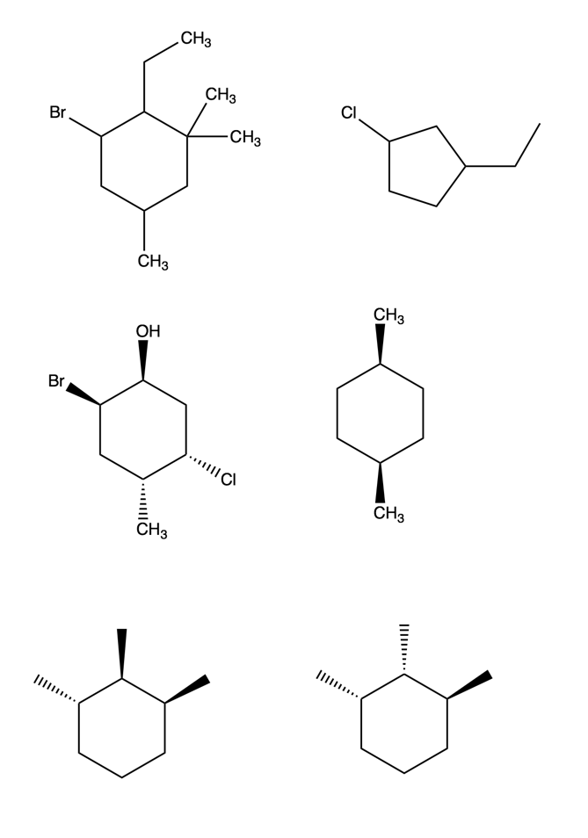
Question 1
1-bromo-2-ethyl-3,3,5-trimethylcyclohexane

Slide 3
Question 1
1-chloro-3-ethylcyclopentane

Slide 4
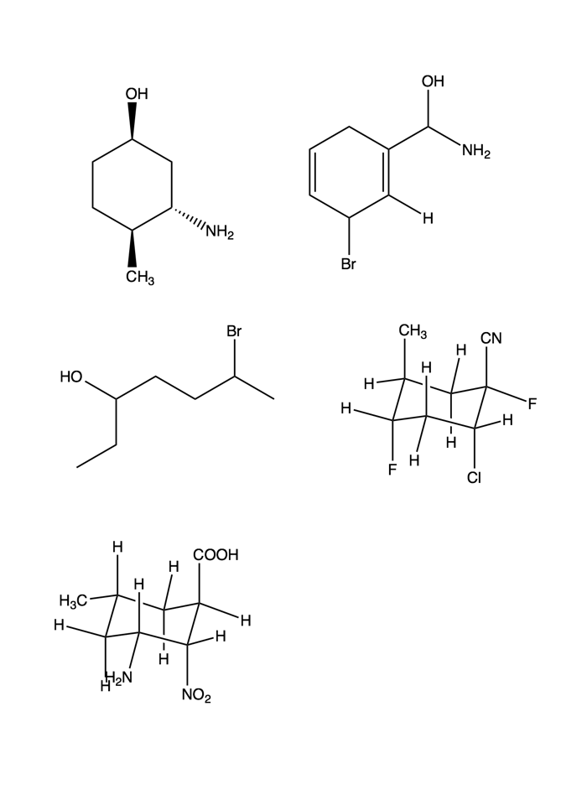
Question 2

Slide 5
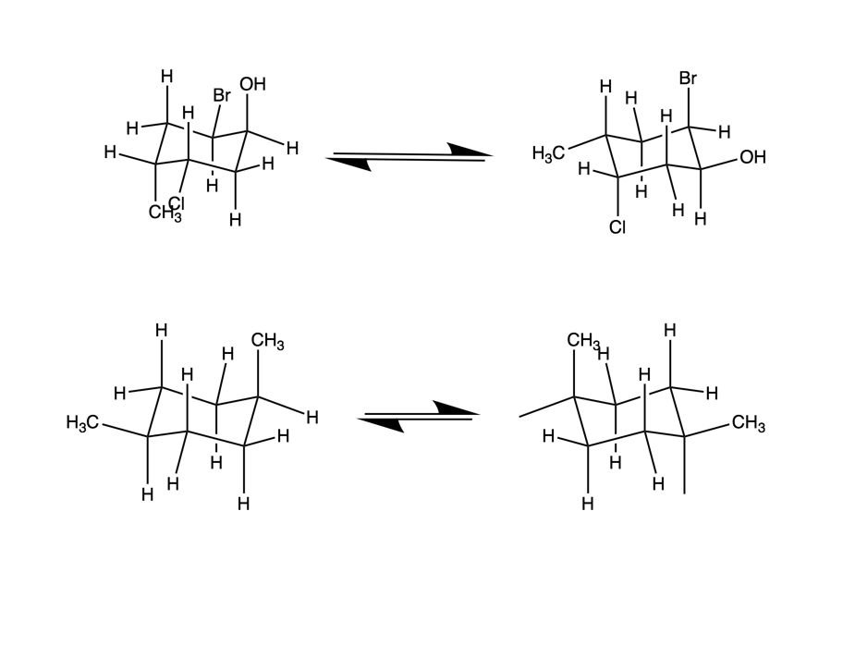
Question 3
11.8 kJ/mol
4 kJ/mol

Slide 6
Question 3
7.6 kJ/mol
7.6 kJ/mol

Slide 7
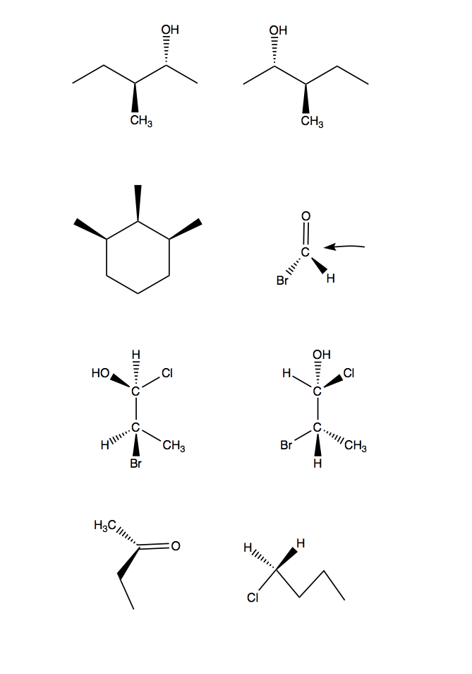
Question 4
Diastereomers

Slide 8
Question 4
Enantiomers

Slide 9
Question 4
Enantiomers

Slide 10
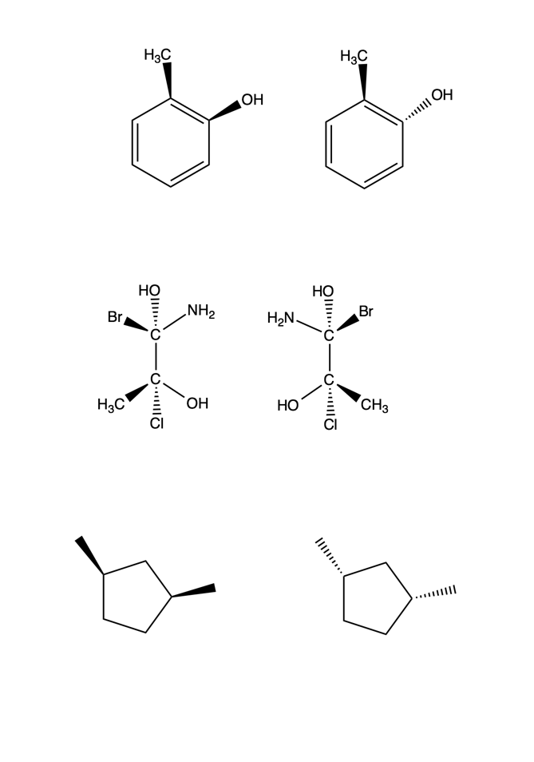
Question 4
Diastereomers

Slide 11
Question 5
Re
Si

Slide 12
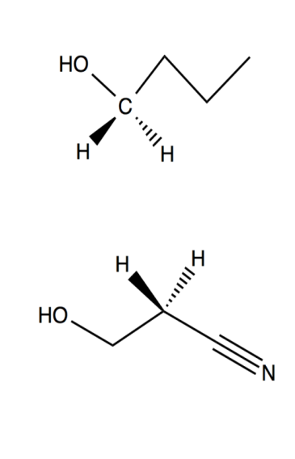
Question 6
Pro-R
Pro-S
Pro-R
Pro-S

Slide 13
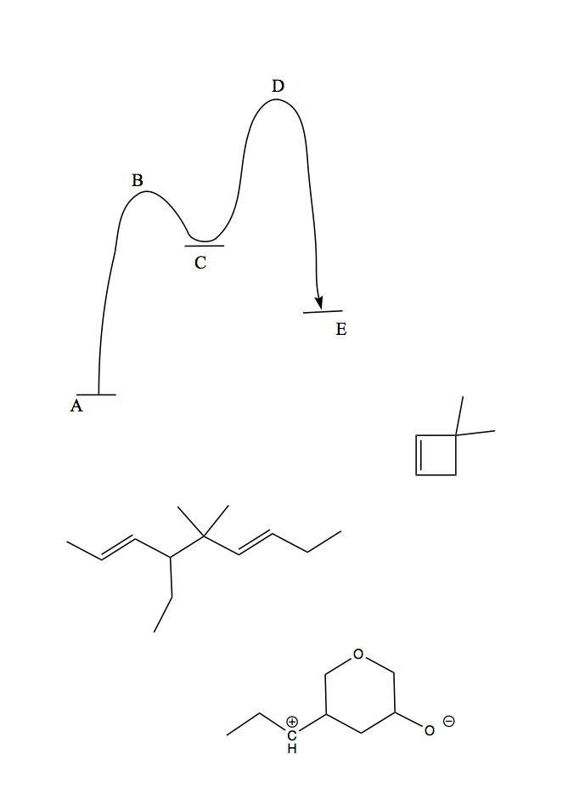
Question 7
Nu
E
E
Nu

Slide 14
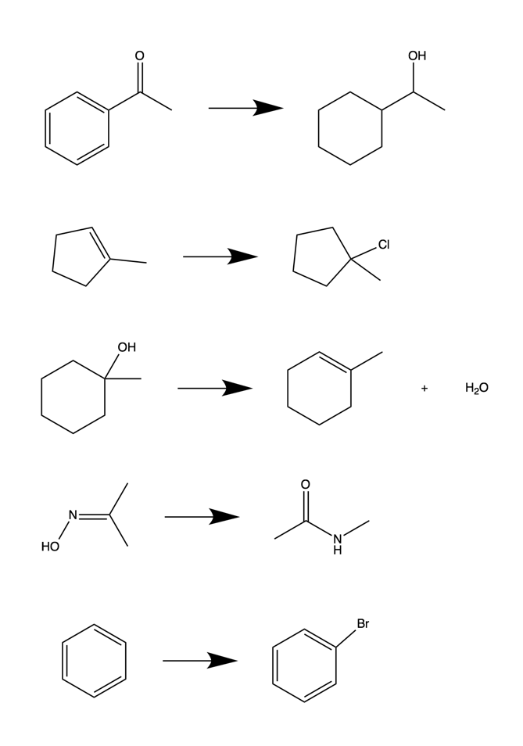
Question 8
Addition

Slide 15
Question 8
Addition

Slide 16
Question 8
Rearrangement

Slide 17
Question 8
Elimination

Slide 18
Question 8
Substitution

Slide 19
Question 9
Keq is larger than 1
The reaction is spontaneous
  Gibbs Free Energy is negative
The reaction is exergonic
The products are “favored”
  The reaction is pushed to the right

Slide 20
Question 10
A : Reactants
B : Transition State of Step 1
C : Intermediate
D : Transition Step of Step 2 (the slow step)
E : Products

Slide 21
Question 11
C₅H₇Br₃O₂ DOU: 1
C₇H₈N₂O DOU: 5
C₁₂H₁₈Cl₃N DOU: 3

Slide 22
Question 12
4-ethyl-5,5-dimethyl-2,6-nondiene
3,3-dimethylcyclobutene

Slide 23
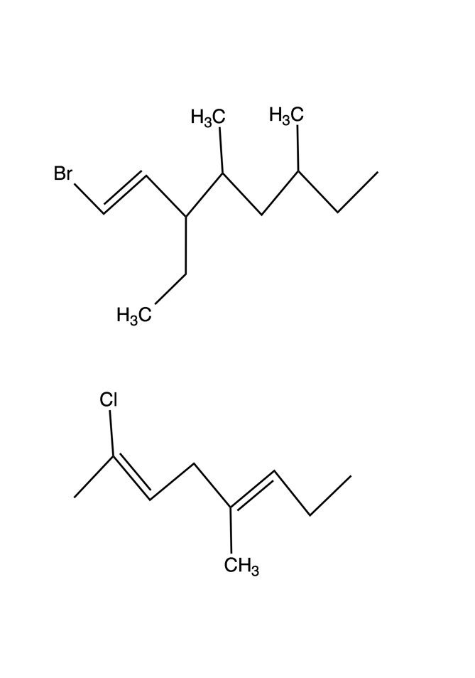
Question 13

Slide 24
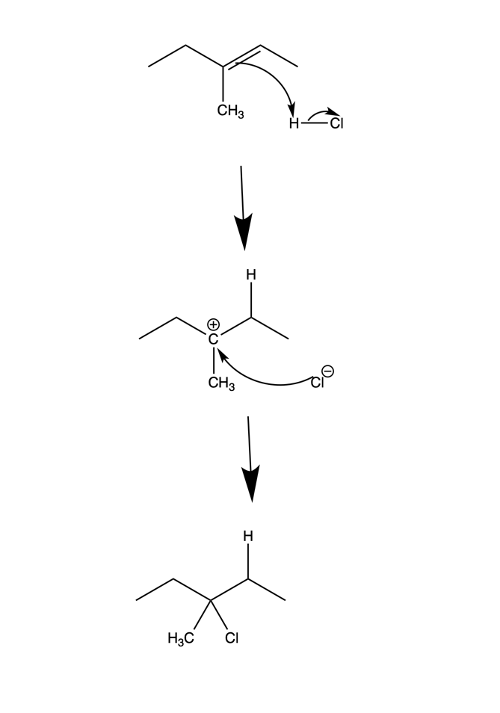
Question 14

